Slide 1
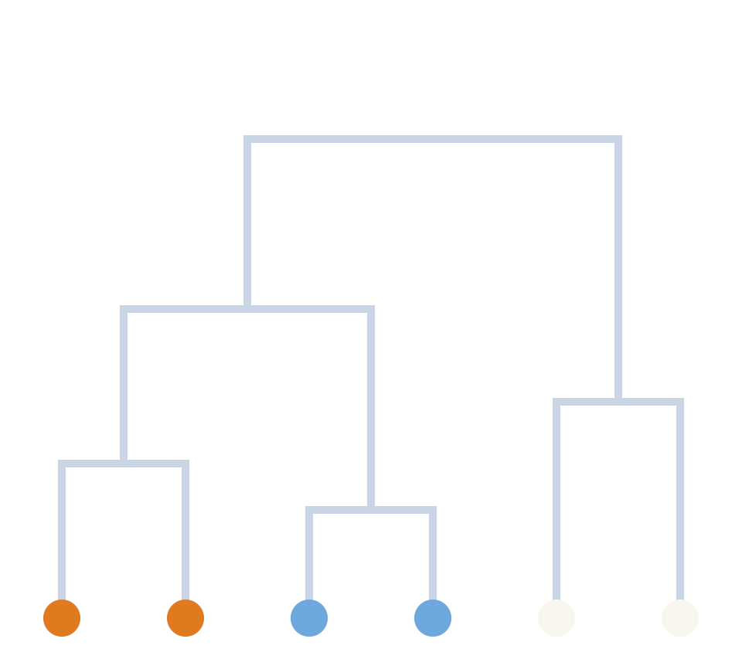
Unsupervised learning
ML & AI FOR LIFE SCIENCES 2026 · DAY 1 · LECTURE 2
Finding groups nobody labelled: k-means, hierarchical and graph clustering
Trần Thượng Vân Du · SIB Swiss Institute of Bioinformatics
VNUHCM-University of Science · 02/11/2026
Notes:
25 min lecture, then Colab clustering practical. Keep pace: about 1.4 min per slide; k-means animation slides go fast (30 s each).

Slide 2

Here are cells from a tissue. No labels. How many types?
A PUZZLE TO START
VI: không có nhãn
Your eyes found groups in under a second.
In 2 dimensions that is easy. In 20,000 dimensions we need an algorithm.
Clustering = making that intuition precise and repeatable.
Notes:
~1 min. Ask the room: "How many groups?" Most say 3. Then: "How did you decide? Could it be 4?" That question is the whole lecture.

Slide 3
Unsupervised learning finds structure in X alone
DEFINITION
VI: học không giám sát
Clustering
Dimensionality reduction
Association & density
Which samples belong together?
Which few axes capture the variation?
Which features co-occur? Which samples are unusual?
No y, so no "right answer" to check against. That makes validation the hard part.
Notes:
~1.5 min. Key contrast with supervised learning: there is no accuracy to compute. We will come back to "how do I know my clusters are real?" at the end.

Slide 4
Clustering created several famous classifications
IN BIOLOGY
VI: ứng dụng sinh học
Breast cancer subtypes
Cell types
Hierarchical clustering of expression → luminal, HER2, basal-like (Perou et al. 2000)
Graph clustering of single-cell RNA-seq → cell atlases
Chromatin states
Patient subgroups
Segmenting the genome by histone marks (ChromHMM, Segway)
Data-driven type 2 diabetes subgroups from clinical variables (Ahlqvist et al. 2018)
Perou et al. Nature 2000 · Ernst & Kellis Nat Methods 2012 · Ahlqvist et al. Lancet Diabetes Endocrinol 2018
Notes:
~1.5 min. Optional personal example: our IMI-RHAPSODY work on multi-omics T2D subgroups builds on the Ahlqvist idea. Emphasise: a cluster is a hypothesis, validated later by outcomes or biology.

Slide 5
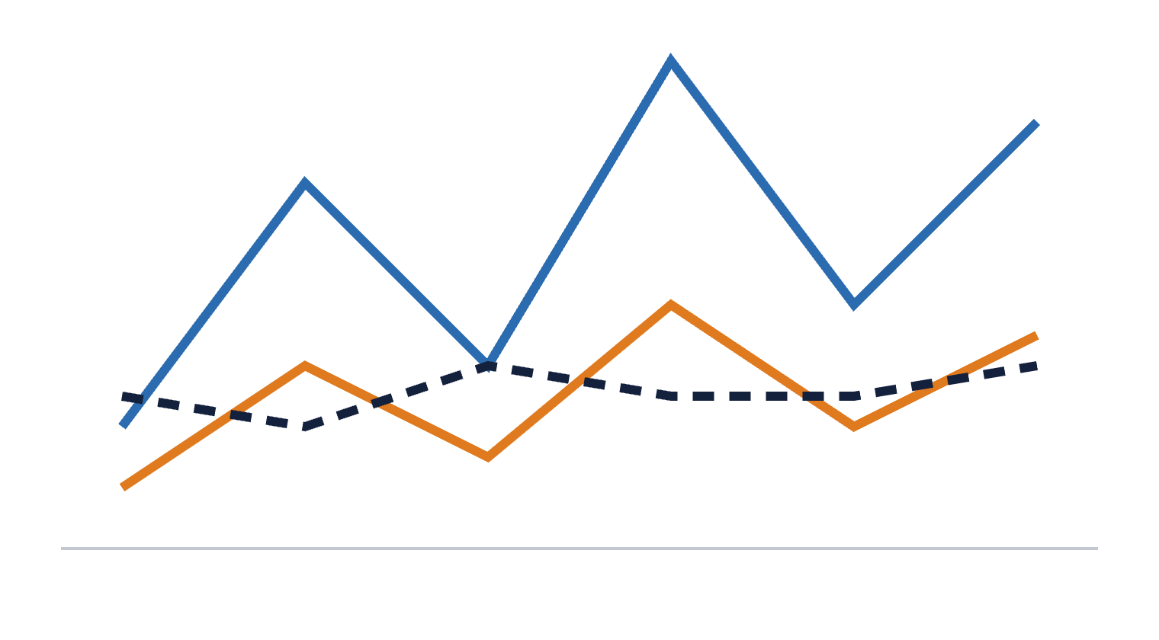
The distance you choose decides the clusters you get
WHAT DOES "SIMILAR" MEAN?
VI: khoảng cách · độ tương đồng
B
Euclidean distance
Compares levels → A is closest to C
A
Correlation distance (1 − r)
Compares shape → A is closest to B
C
Co-regulated genes share shape, not level: correlation is often the better choice for them.
6 genes
Notes:
~1.5 min. Ask first: "Which profile is most similar to A?" Both answers are right; it depends on the question. For CS participants: k-means implicitly uses Euclidean distance.

Slide 6
Without scaling, the loudest feature wins
SCALING
VI: chuẩn hóa dữ liệu
The problem
The fix
But think first
Glucose in mg/dL (70–300) and HbA1c in fraction (0.04–0.12).
log for skewed counts, then z-score each feature:
Scaling also inflates noisy, low-expressed genes.
Distances are almost entirely glucose. HbA1c is ignored.
z = (x − mean) / sd
Common practice: keep the top 1,000–5,000 most variable genes, then scale.
Every feature now has mean 0, sd 1.
Notes:
~1.5 min. Same rule applies to PCA (L1), k-NN, SVM, regularised regression. Trees (L4–L5) do not need scaling. Skip-if-late: the third card.

Slide 7
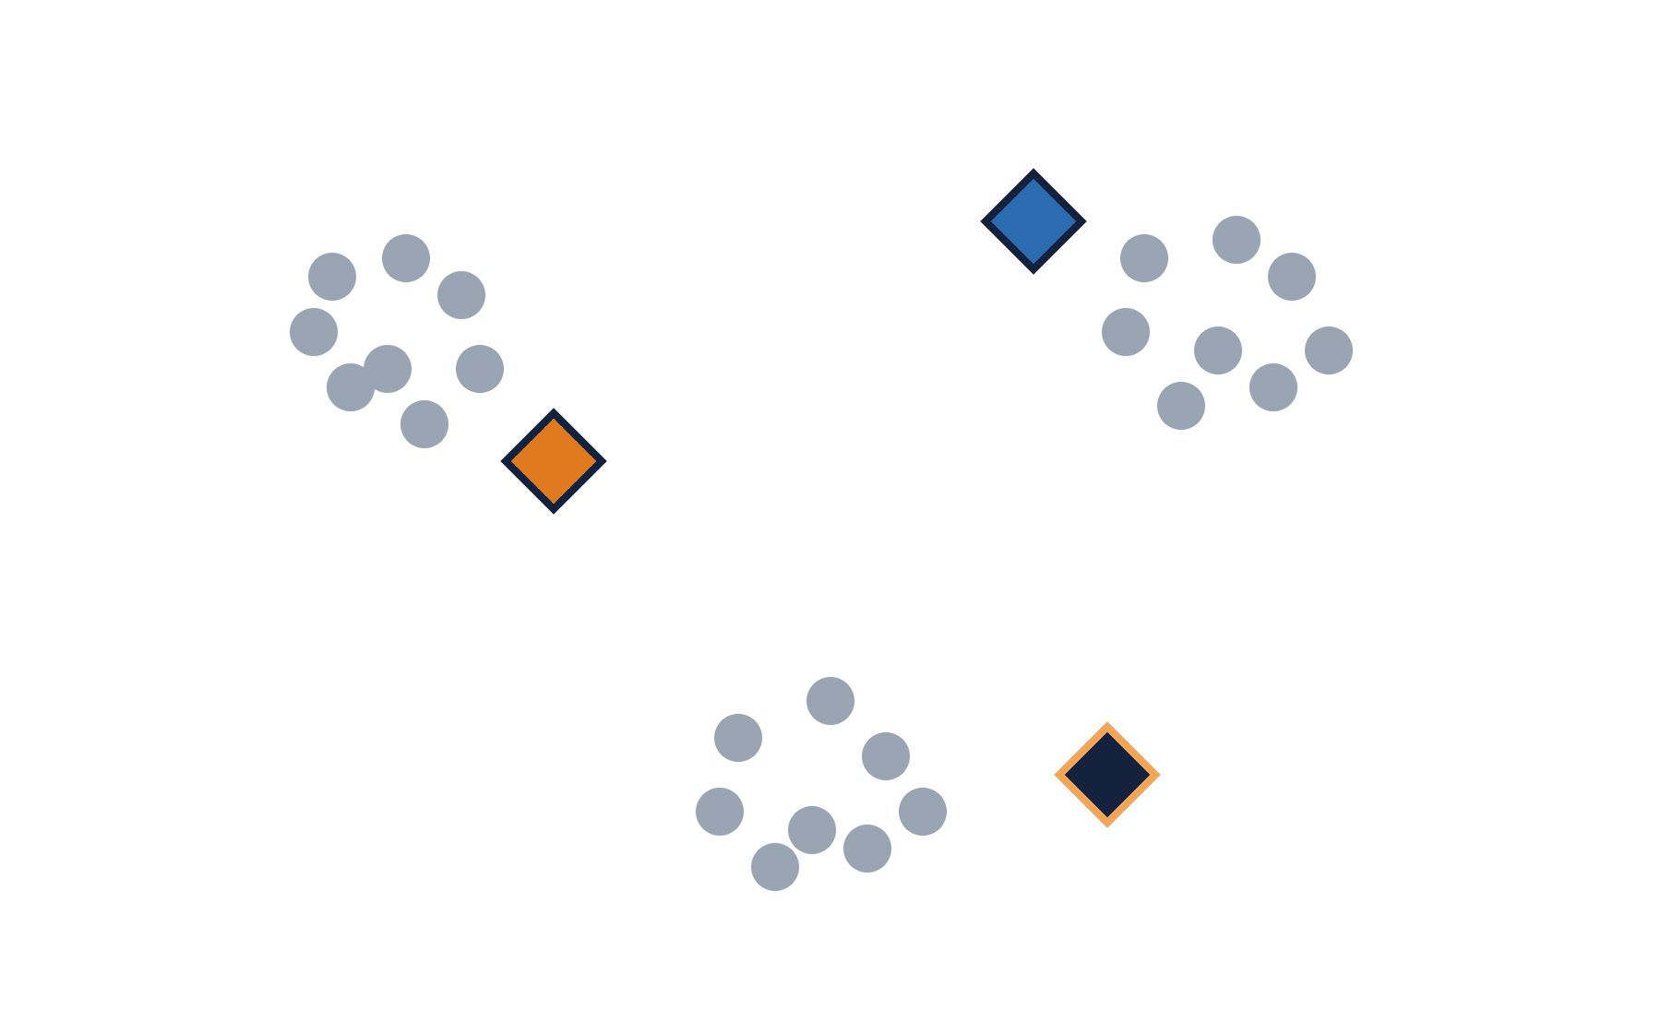
Choose k = 3 and drop three centroids at random
K-MEANS · STEP 1 OF 4
VI: tâm cụm (centroid)
1 · Place k centroids at random
2 · Assign each point to the nearest centroid
3 · Move each centroid to the mean of its points
4 · Repeat 2–3 until nothing changes
Notes:
~30 s. Diamonds = centroids. Note that we had to choose k ourselves.

Slide 8
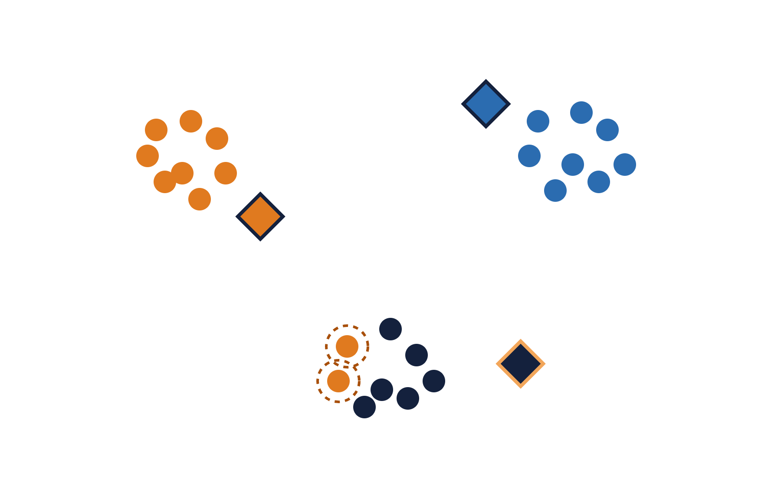
Each point joins its nearest centroid
K-MEANS · STEP 2 OF 4
VI: gán điểm vào cụm
1 · Place k centroids at random
2 · Assign each point to the nearest centroid
3 · Move each centroid to the mean of its points
4 · Repeat 2–3 until nothing changes
Circled: two bottom points go to orange, for now.
Notes:
~30 s. Point to the two circled points: wrong group because the starting centroids were poor.

Slide 9
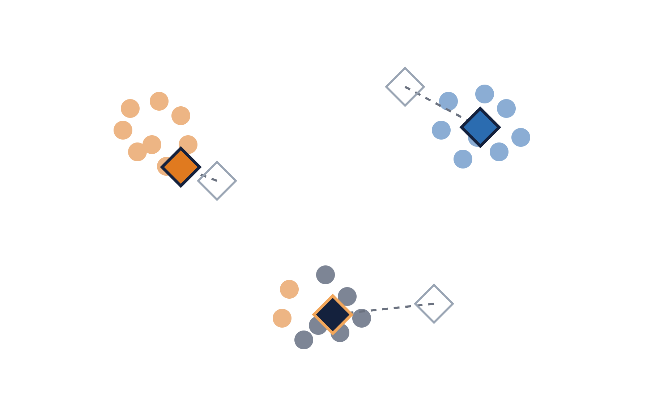
Each centroid moves to the mean of its points
K-MEANS · STEP 3 OF 4
VI: cập nhật tâm cụm
1 · Place k centroids at random
2 · Assign each point to the nearest centroid
3 · Move each centroid to the mean of its points
4 · Repeat 2–3 until nothing changes
Outlines = old positions; dashed = movement.
Notes:
~30 s. "k-means" = k centroids, each the MEAN of its points. The orange centroid is pulled down by the two misassigned points.

Slide 10
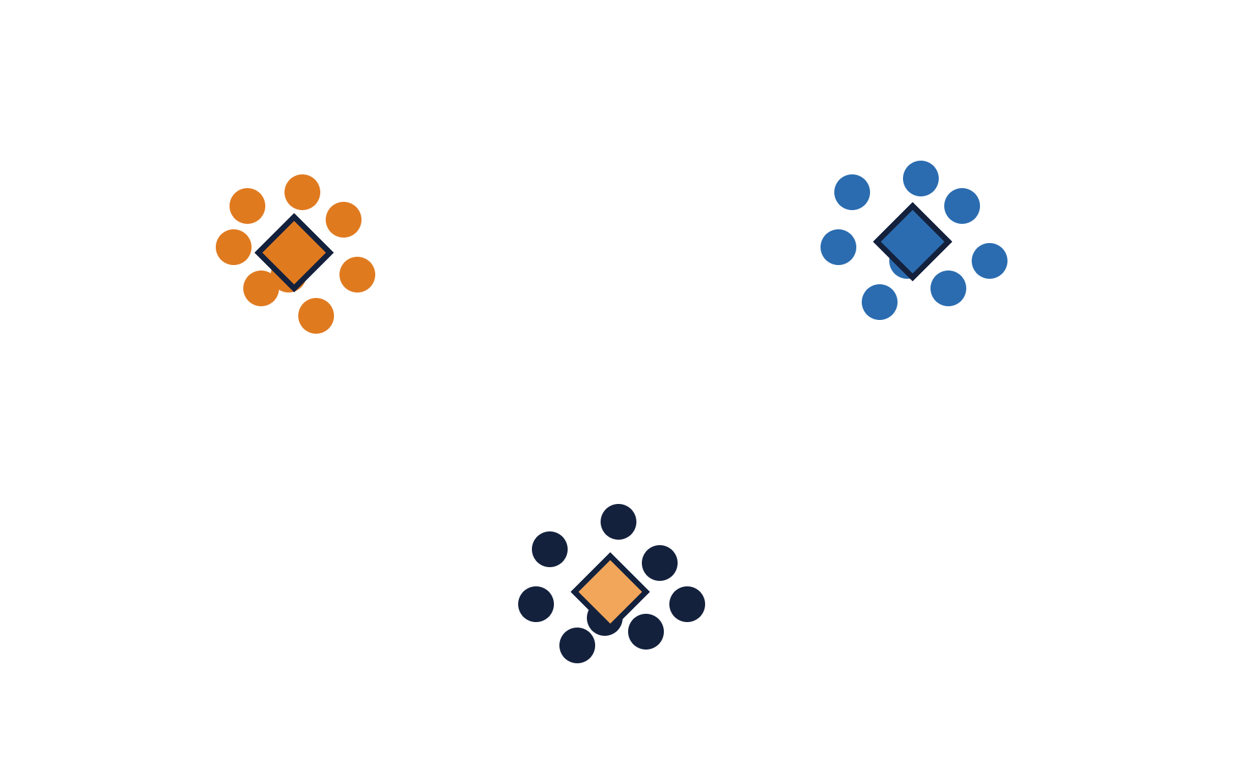
Repeat until no point changes cluster
K-MEANS · STEP 4 OF 4
VI: hội tụ
1 · Place k centroids at random
2 · Assign each point to the nearest centroid
3 · Move each centroid to the mean of its points
4 · Repeat 2–3 until nothing changes
Goal: minimise the total squared distance of points to their centroid (within-cluster sum of squares).
Notes:
~45 s. Converged. Mention: a different random start can give a different answer; scikit-learn runs several starts (n_init) and keeps the best, using k-means++ initialisation.

Slide 11
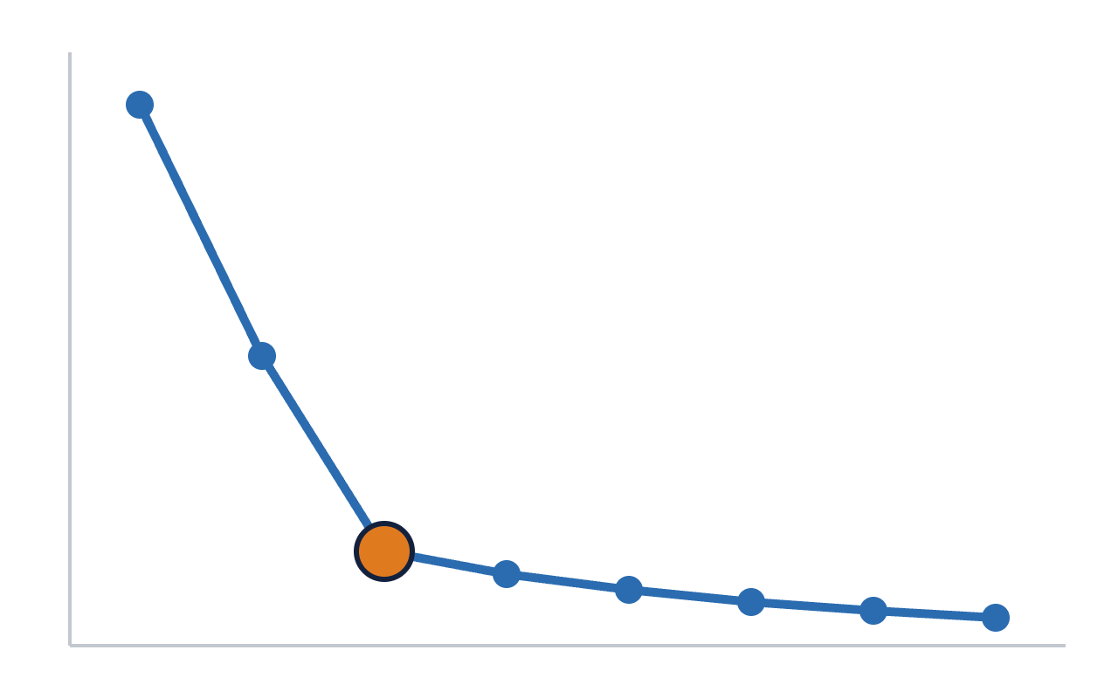
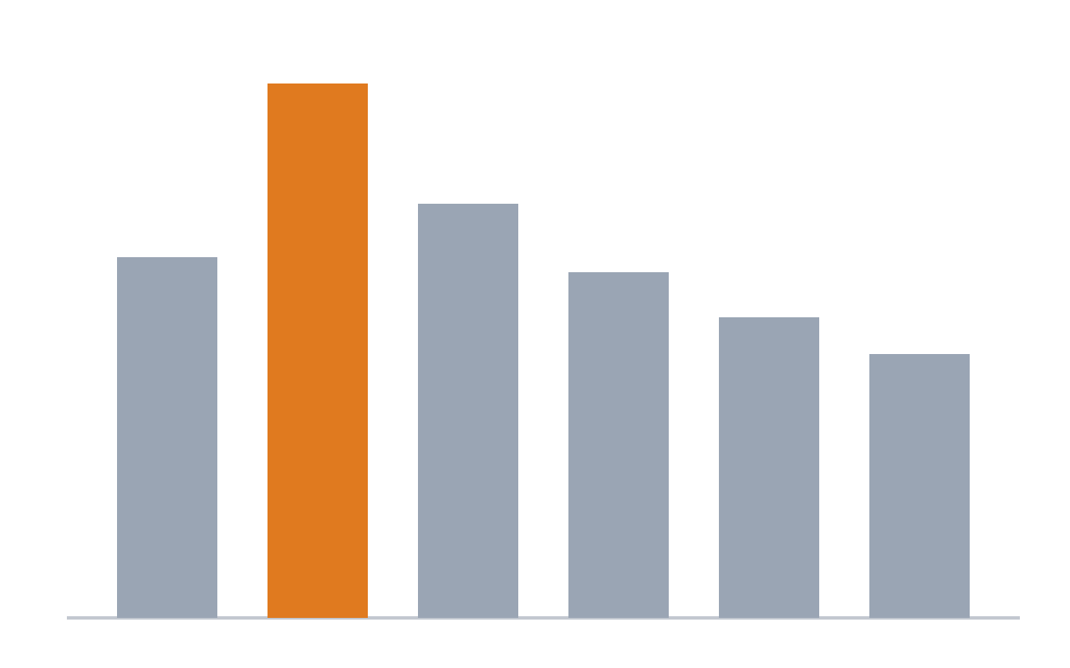
Two quick tools to choose k, plus your biology
CHOOSING K
VI: chọn số cụm k
Elbow plot
Silhouette score
Within-cluster spread vs k (1–8). Pick the bend: k = 3.
How well each point fits its own cluster vs the next one (−1 to 1). Highest at k = 3.
Real data rarely gives a clean answer. Biology and stability decide too.
Notes:
~2 min. Silhouette for one point = (b − a) / max(a, b), with a = mean distance to its own cluster, b = mean distance to the nearest other cluster. Both tools are in scikit-learn; students compute them in Colab.

Slide 12
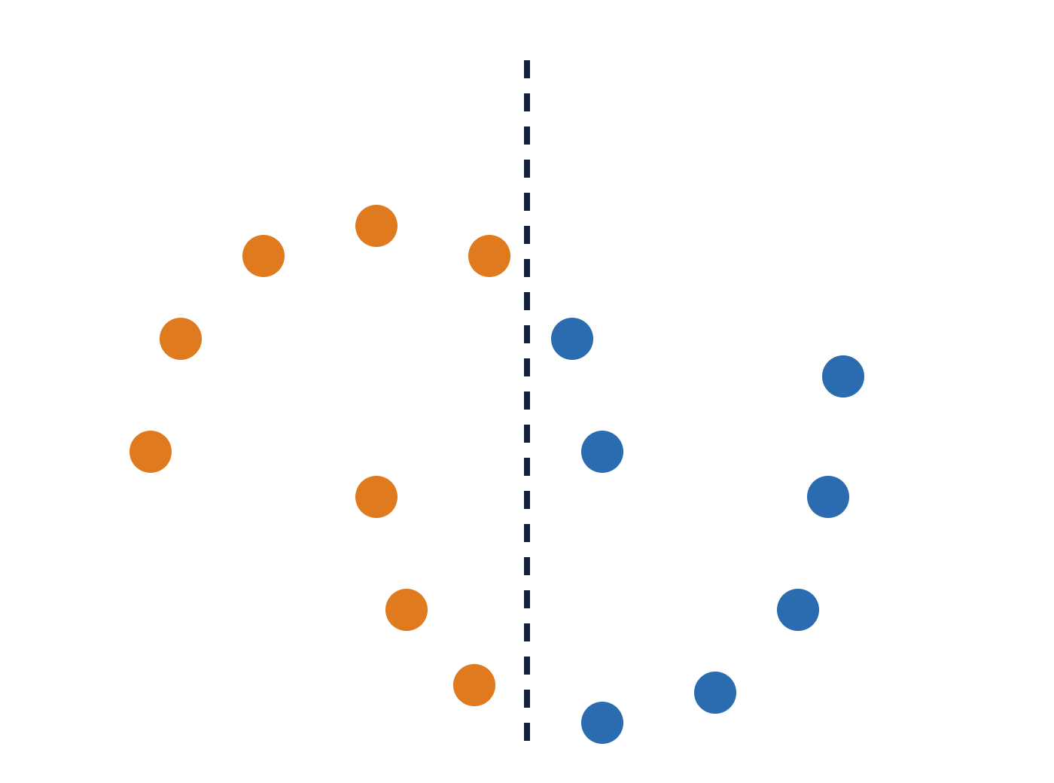
k-means assumes round, similar-sized blobs
K-MEANS · LIMITS
VI: hạn chế của k-means
Shape: two crescents are cut in half.
Random start: different runs can disagree.
Outliers: a single extreme sample pulls a mean.
You must give k.
Alternatives: hierarchical, DBSCAN (density), Gaussian mixtures, graph-based.
Orange / blue = k-means split; dashed = its boundary
Notes:
~1.5 min. This is the classic "two moons" example; reproduce it in Colab with sklearn.datasets.make_moons. Point: every algorithm has a built-in idea of what a cluster looks like.

Slide 13
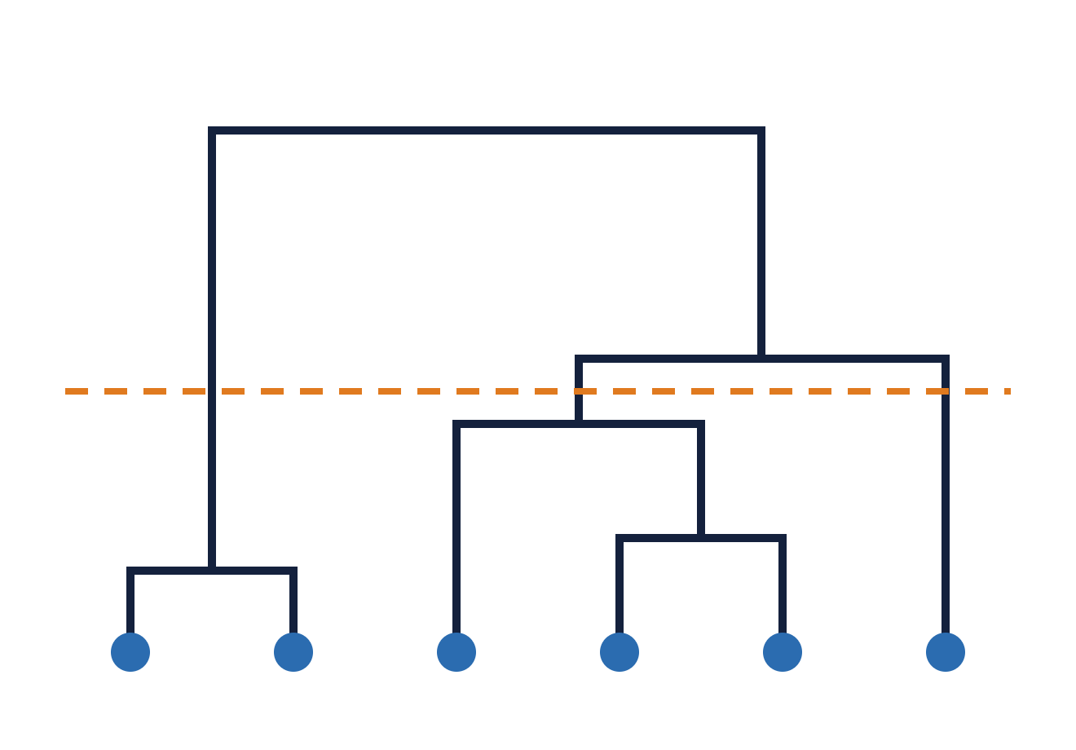
Merge the two closest groups, again and again
HIERARCHICAL CLUSTERING
VI: phân cụm phân cấp · cây phân nhánh
Start: each sample is its own cluster. Height of a join = distance at which groups merged. No k needed upfront: cut the tree where you like.
Linkage = distance between groups
Linkage | Uses
Single | Closest pair → long chains
Complete | Farthest pair → compact
Average | Mean of all pairs
Ward | Smallest increase in variance
cut → 3
Notes:
~2 min. Ward or average linkage are good defaults for expression data; single linkage is rarely what you want. Cost grows with n², so it suits hundreds of samples, not a million cells.

Slide 14
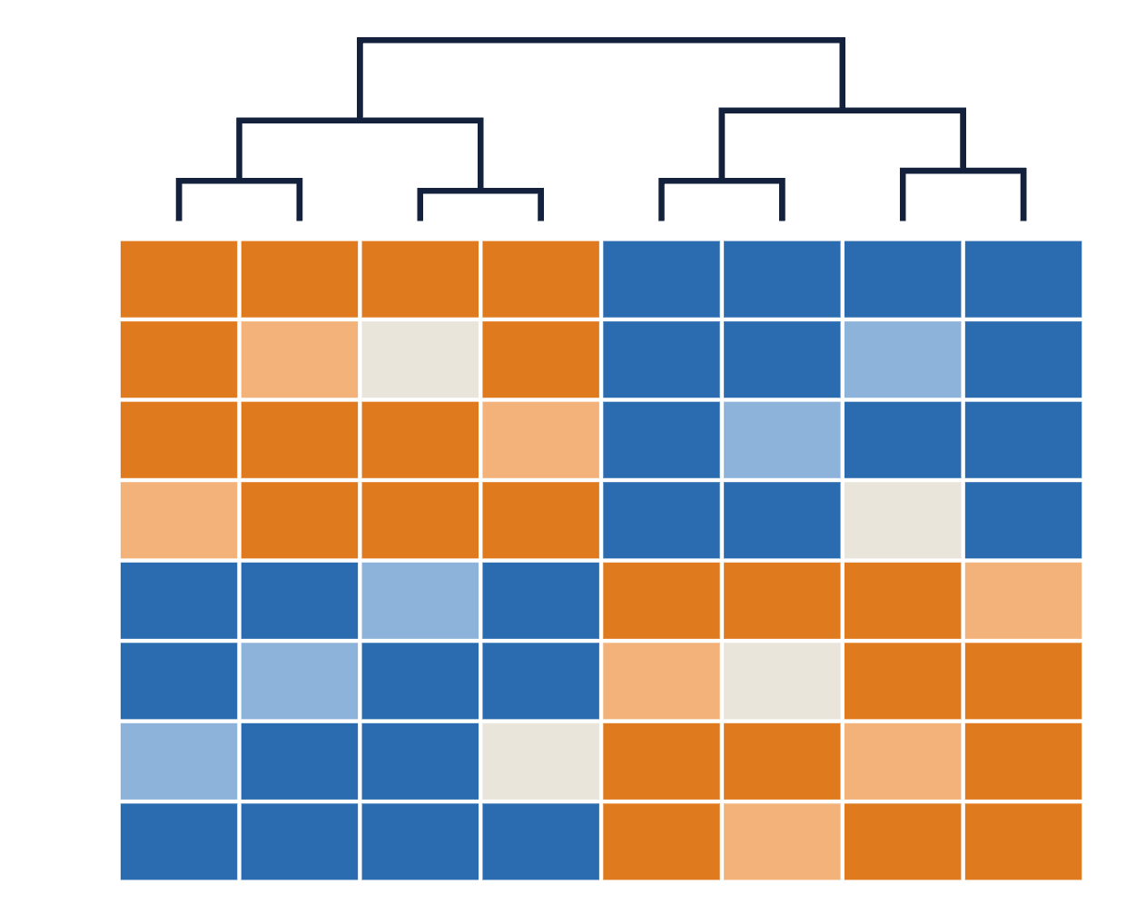
A clustered heatmap shows samples and genes together
THE OMICS CLASSIC
VI: bản đồ nhiệt
Columns = samples, ordered by the dendrogram on top.
Rows = genes (z-scored); orange = high, blue = low.
Two sample groups, each with its own gene block: the pattern behind most "subtype" figures.
seaborn.clustermap · R: pheatmap, ComplexHeatmap
Notes:
~1.5 min. Warning to plant now: if the 8 genes were chosen BECAUSE they differ between the groups, this picture proves nothing. See circularity, two slides ahead.

Slide 15
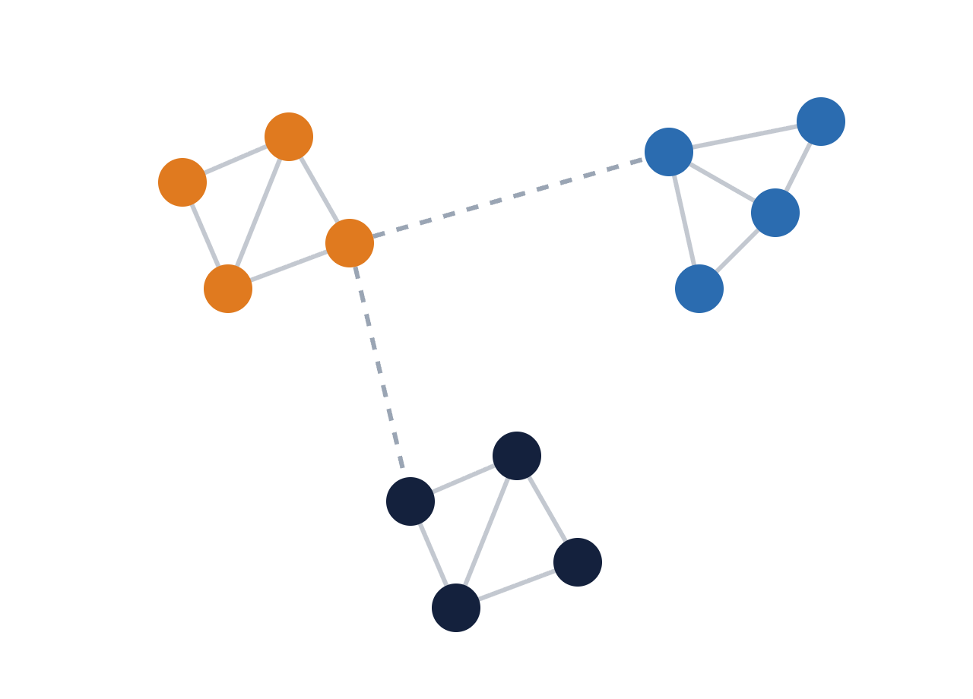
Single-cell data is clustered as a network of neighbours
GRAPH-BASED CLUSTERING
VI: phân cụm dựa trên đồ thị
1 · Build the k-nearest-neighbour graph (same as UMAP, Lecture 1).
2 · Find communities: groups with many links inside and few between.
Leiden (or Louvain) is the default in Scanpy and Seurat; scales to millions of cells.
Resolution parameter ↑ → more, smaller clusters. Another "k" in disguise.
Traag, Waltman & van Eck, Sci Rep 2019 (Leiden algorithm)
Notes:
~1 min. Mention only; not in the Colab core, but a stretch cell runs Leiden on PBMC3k for interested participants.

Slide 16
Clustering always returns clusters. Are they real?
VALIDATION · POLL
VI: các cụm có thật không?
Internal
Stability
Silhouette: are clusters compact and separated?
Re-cluster on 80% subsamples: do the same groups come back?
External
Biological
Adjusted Rand Index vs known labels, if any (1 = perfect, 0 = chance)
Known markers? Different outcomes? Replicated in another cohort?
Trust a cluster only when several of these agree.
Notes:
~2 min. Poll before showing the cards: run k-means with k = 4 on pure random noise and show the result. Ask: "Are these 4 groups real?" Hands up. Then show the four kinds of evidence.

Slide 17
Beware circular analysis
PITFALLS
VI: phân tích vòng lặp (double dipping)
Double dipping
Labels built from features
Batch = cluster
Cluster cells, then test which genes differ between clusters using the same data.
PAM50 breast cancer subtypes are defined from expression of 50 genes.
If clusters line up with sequencing date or hospital, you clustered the batch.
The clusters were made to differ, so p-values are far too small.
Recovering them by clustering expression is partly a circle, not a discovery.
Always cross-tabulate clusters × metadata.
Zhang, Kamath & Tse, Cell Systems 2019 · Parker et al. J Clin Oncol 2009 (PAM50)
Notes:
~1.5 min. These are the most common reviewer complaints about clustering papers. The Colab notebook includes a cross-tab of clusters vs batch.

Slide 18
Three things to remember
TAKE-AWAYS → COLAB
1
2
3
Distance and scaling choices shape the clusters as much as the algorithm.
k-means: fast, needs k, likes round blobs. Hierarchical: a tree you cut.
A cluster is a hypothesis: check stability, metadata and biology.
Notes:
~1 min. Hand over. While walking around ask: "Which k did you choose, and why?"

